Slide 1
Student Database Project
Front end using HTML, CSS
Backend Using Python Django Framework

Slide 2
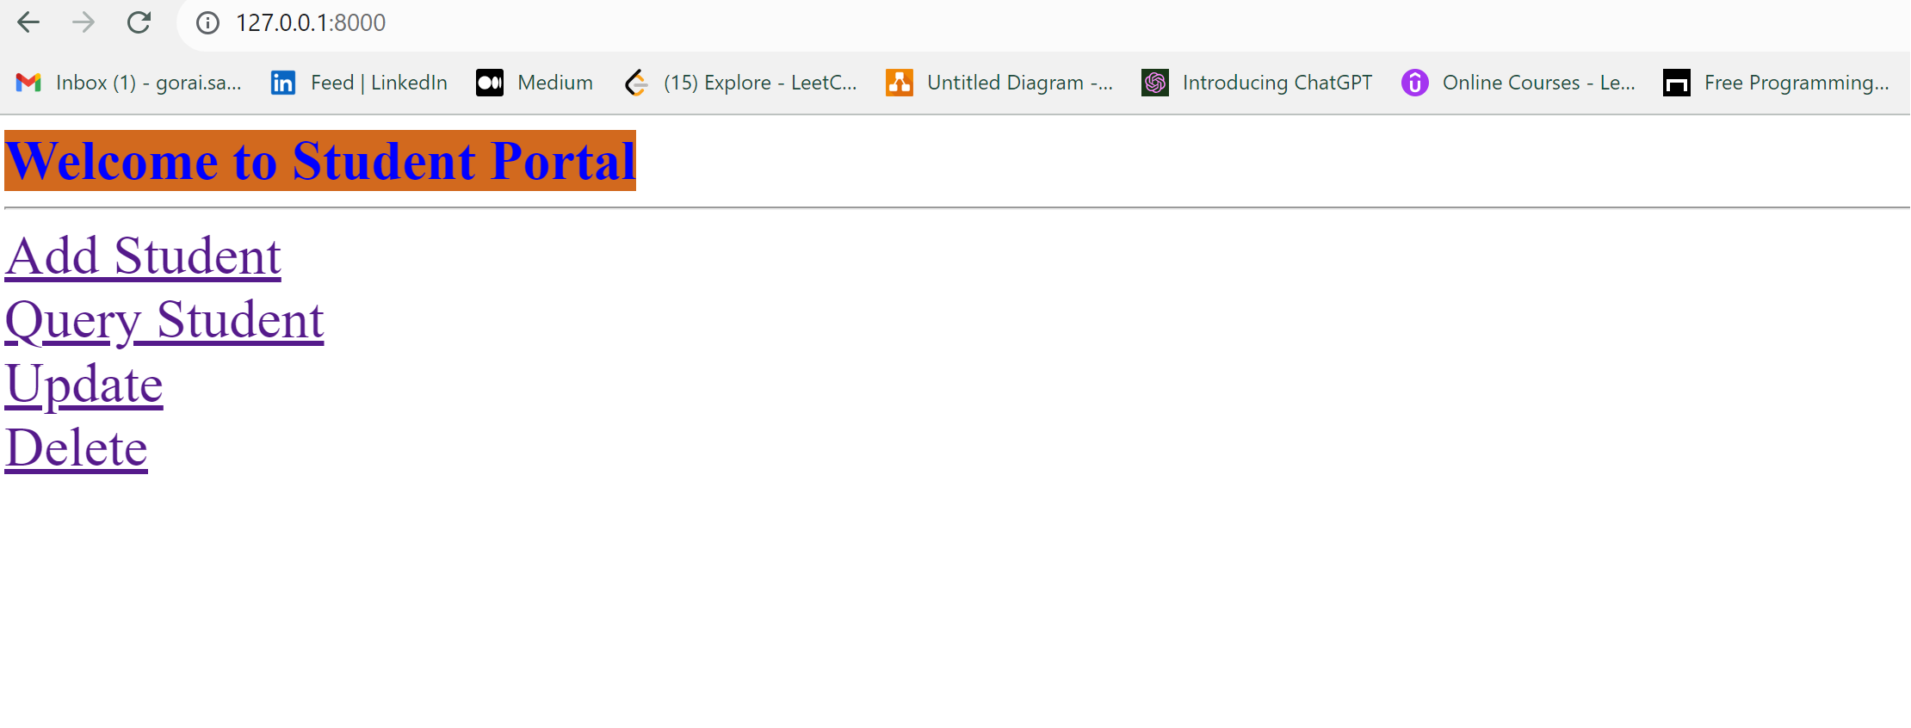
Home Page

Slide 3
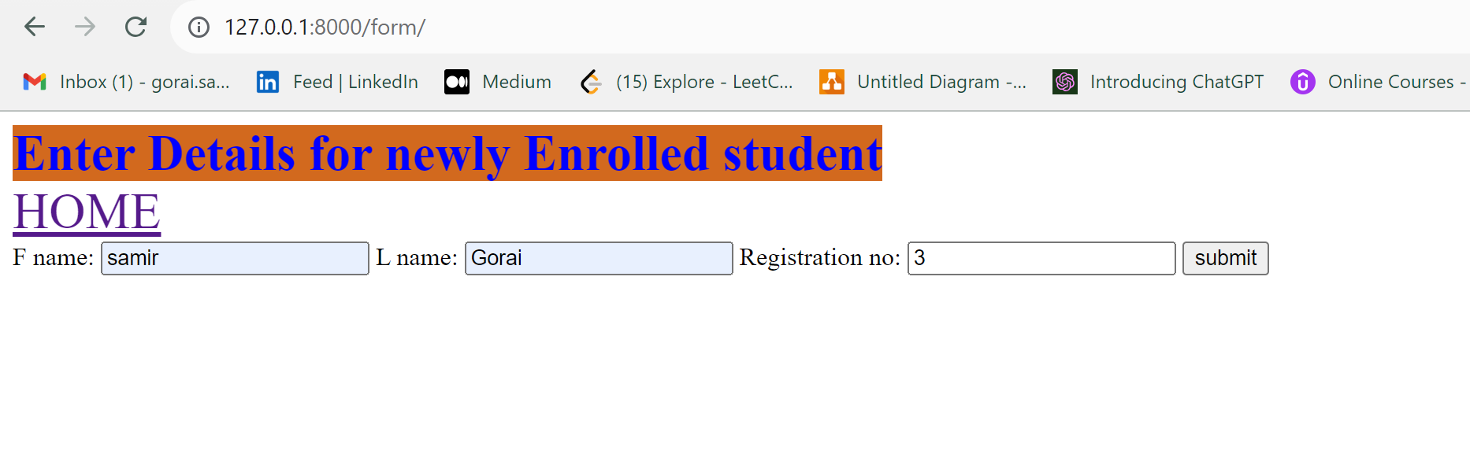
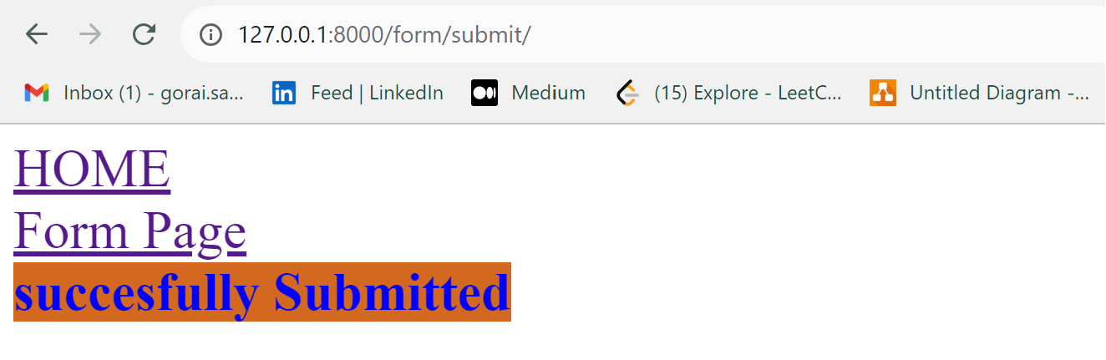
CREATE:
>In this page we can add new student details by entering First Name Last Name and Registration no
>Registration no is Primary Key(Unique) if a new Registration no is entered it is successfully added into the
database

Slide 4
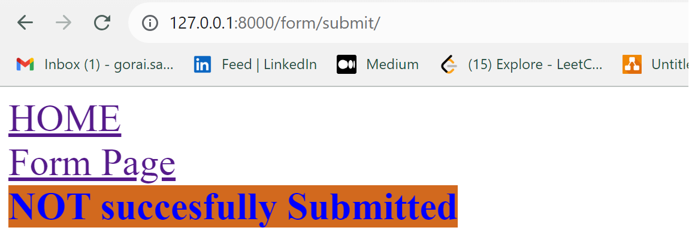
If an Registration no already and user try to create a students details with same registration no then the details is not saved to database.

Slide 5
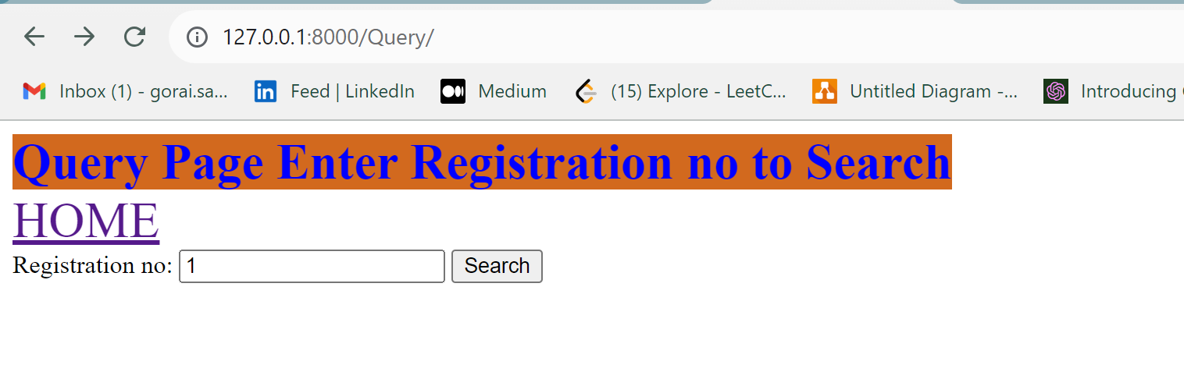
Read
Here User can search for a students details
by entering his/her Registration no

Slide 6
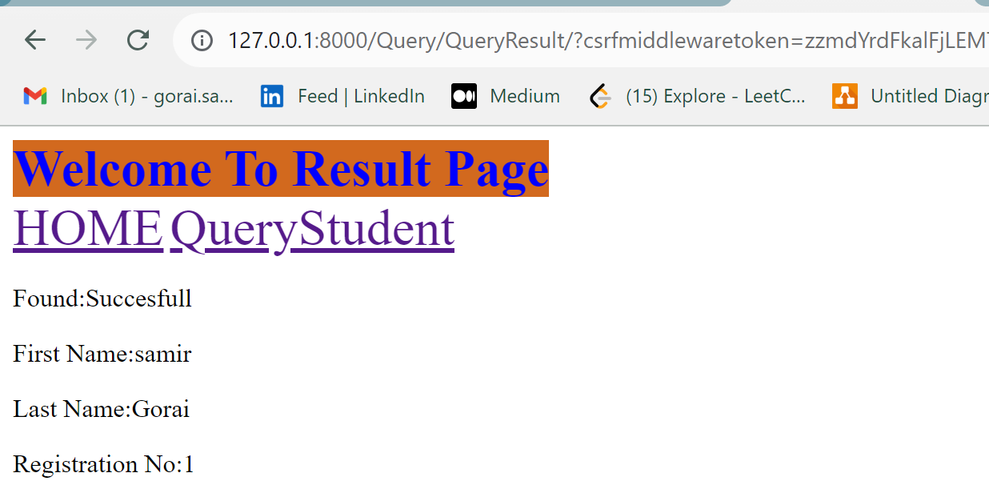
After successfully finding the data

Slide 7
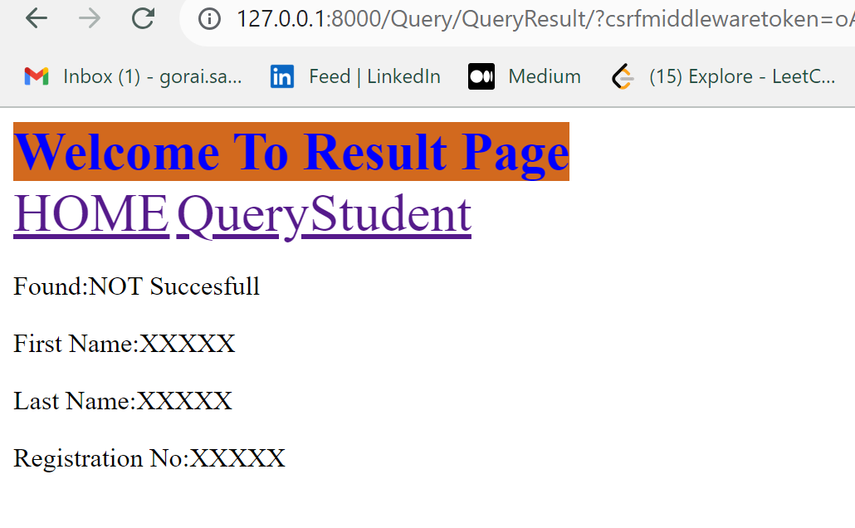
If the Details is not found with the searched
Registration no the following page is displayed

Slide 8
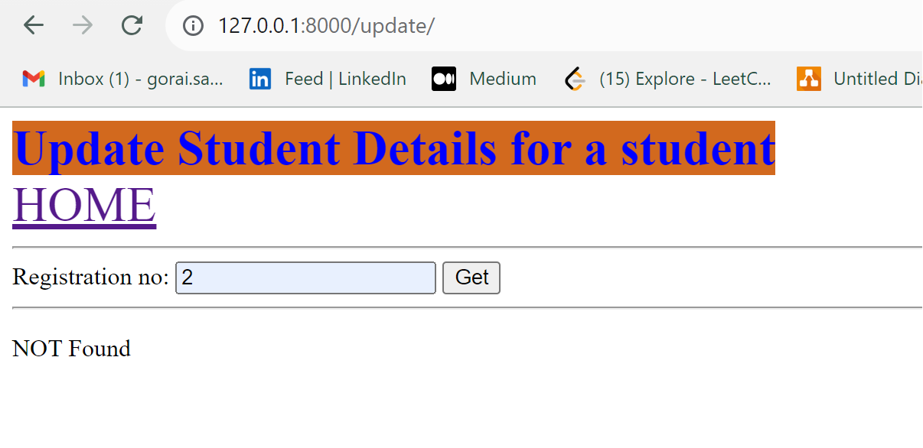
Update:
User can Search for a Students registration no.

Slide 9
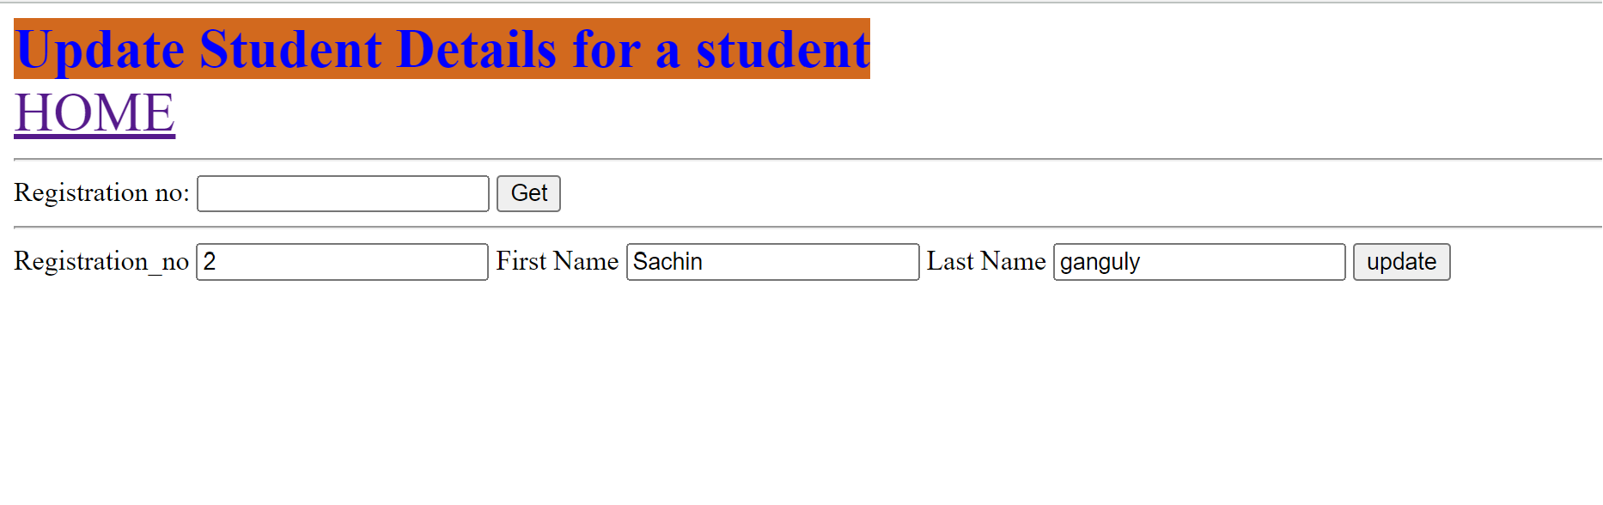
User can update the First Name or Last Name or both field.

Slide 10
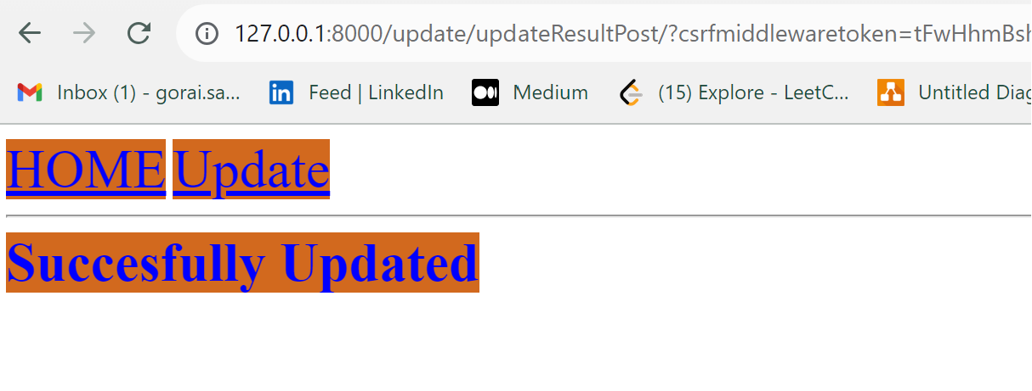
After Succesfully updating Details

Slide 11
If a Students Details are not found the following page is
displayed

Slide 12
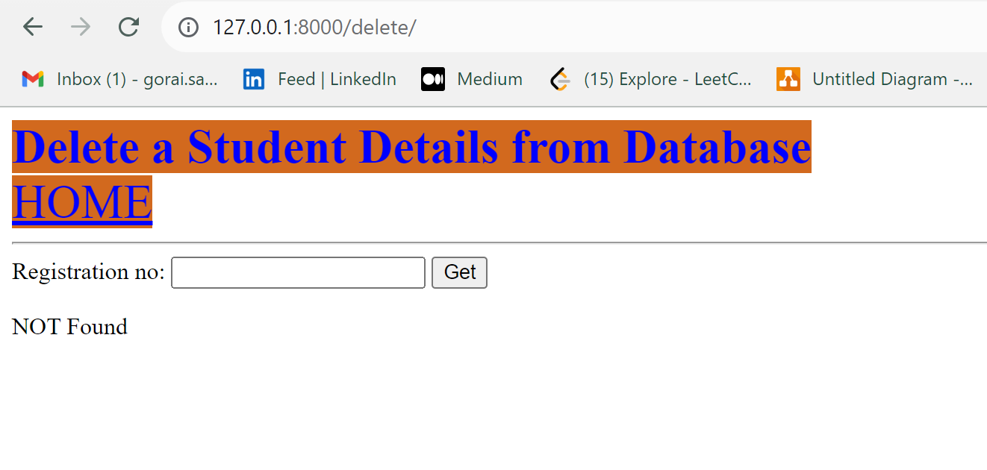
Delete
Delete Home Page

Slide 13
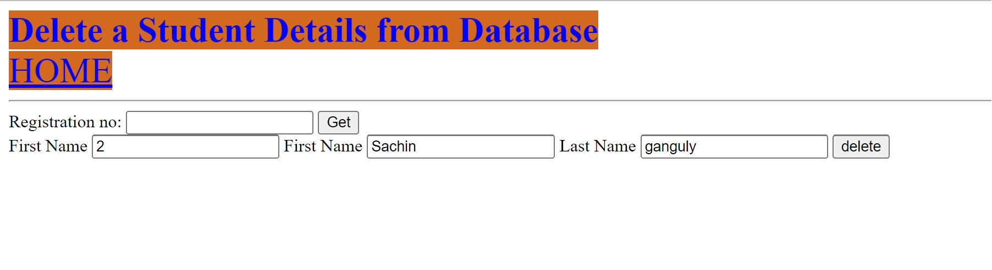
After a Registration no is successfully found it is then displayed on page
And user can delete the details for a particular student

Slide 14
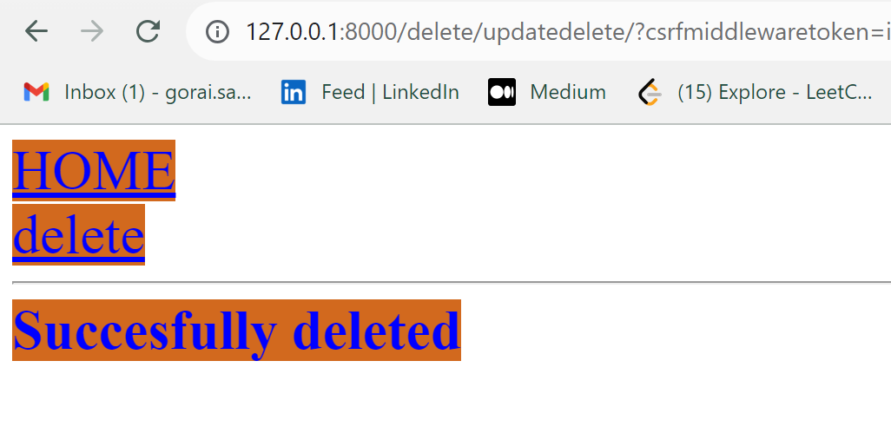
After Successfully deleting a student details

Slide 15
If a Data is not found for a searched Registration no
this page is displayed

